Slide 1
DR.SNSRCAS, CBE
SUBJECT: ADVANCED JAVA PROGRAMMING
COURSE CODE:16UCA502
TITLE: Compare the doGet() and doPost()
YEAR: V SEMESTER 2022-2023 (ODD)

Slide 3
session tracking
HTTP is a "stateless" protocol which means each time a client retrieves a Web page, the client opens a separate connection to the Web server and the server automatically does not keep any record of previous client request. Still there are following three ways to maintain session between web client and web server

Slide 4
session tracking
1) Cookies
2) Hidden Form Fields
3) URL Rewriting
4) The HttpSession Object

Slide 5
session tracking
1) Cookies
A webserver can assign a unique session ID as a cookie to each web client and for subsequent requests from the client they can be recognized using the recieved cookie.
This may not be an effective way because many time browser does not support a cookie, so I would not recommend to use this procedure to maintain the sessions.

Slide 6
session tracking
2)Hidden Form Fields
A web server can send a hidden HTML form field along with a unique session ID as follows −<input type = "hidden" name = "sessionid" value = "12345">

Slide 7
session tracking
2)Hidden Form Fields
This entry means that, when the form is submitted, the specified name and value are automatically included in the GET or POST data. Each time when web browser sends request back, then session_id value can be used to keep the track of different web browsers.

Slide 8
session tracking
3) URL Rewriting
You can append some extra data on the end of each URL that identifies the session, and the server can associate that session identifier with data it has stored about that session.
For example, with http://tutorialspoint.com/file.htm;sessionid = 12345, the session identifier is attached as sessionid = 12345 which can be accessed at the web server to identify the client.

Slide 9
session tracking
3) URL Rewriting
URL rewriting is a better way to maintain sessions and it works even when browsers don't support cookies. The drawback of URL re-writing is that you would have to generate every URL dynamically to assign a session ID, even in case of a simple static HTML page.

Slide 10
session tracking
3) URL Rewriting
URL rewriting is a better way to maintain sessions and it works even when browsers don't support cookies. The drawback of URL re-writing is that you would have to generate every URL dynamically to assign a session ID, even in case of a simple static HTML page.

Slide 11
session tracking
4) The HttpSession Object
Apart from the above mentioned three ways, servlet provides HttpSession Interface which provides a way to identify a user across more than one page request or visit to a Web site and to store information about that user.

Slide 12
session tracking
The servlet container uses this interface to create a session between an HTTP client and an HTTP server. The session persists for a specified time period, across more than one connection or page request from the user.

Slide 13
session tracking
HttpSession session = request.getSession();

Slide 14
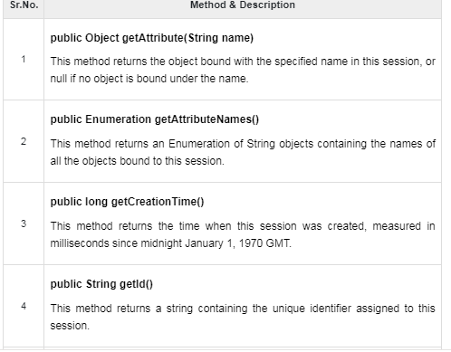
session tracking

Slide 15
THANK YOU

